Slide 1
Assignment
For each case, construct a BFO-conformant design pattern with justification
https://github.com/Applied-Ontology-Education/2025-C-FORS-BFO-Session
Design Pattern Guidance
Include a legend or key
Visually distinguish classes from instances from strings
Distingish direct relations from shortcuts
Read arrows as reflecting “any instance of class X arrow some instance of class Y”
Carefully determine how specific/broad to make your design patterns
Submission Guidance
Create a GitHub account and fork the C-FORS BFO Summer repo (see here for GitHub guidance)
Save a diagram reflecting your design pattern to your forked repository in the “Submit” directory
Save a written justification of your design pattern choices
Open a Pull Request to the C-FORS repository

Slide 2
Case 1
In aircraft_data.xlsx you will find a row for the Airbus A320 Neo.
Construct a BFO-conformant design pattern reflecting the content of every column associated with that row.

Slide 3
Case 2
In aircraft_data.xlsx you will find a row for the Airbus A321-111, designed to have a maximum knot approach speed of 142. However, after 5 approaches, an instance has obtained an average maximum knot approach speed of 139.
Construct a BFO-conformant design pattern reflecting the preceding phenomena.

Slide 4
Case 3
In soc_structure_definitions.xlsx you will find three “SOC_TITLE” entries that mention “Aerospace Engineer”.
Construct a BFO-conformant design pattern that reflects all three entries and their respective “SOC Definitions”.

Slide 5
Case 4
In employment_wage_May_2024.xlsx you will find three “OCC_TITLE” entries that mention “Aerospace Engineer”.
Construct a BFO-conformant design pattern that reflects all three entries and their associated column information.

Slide 6
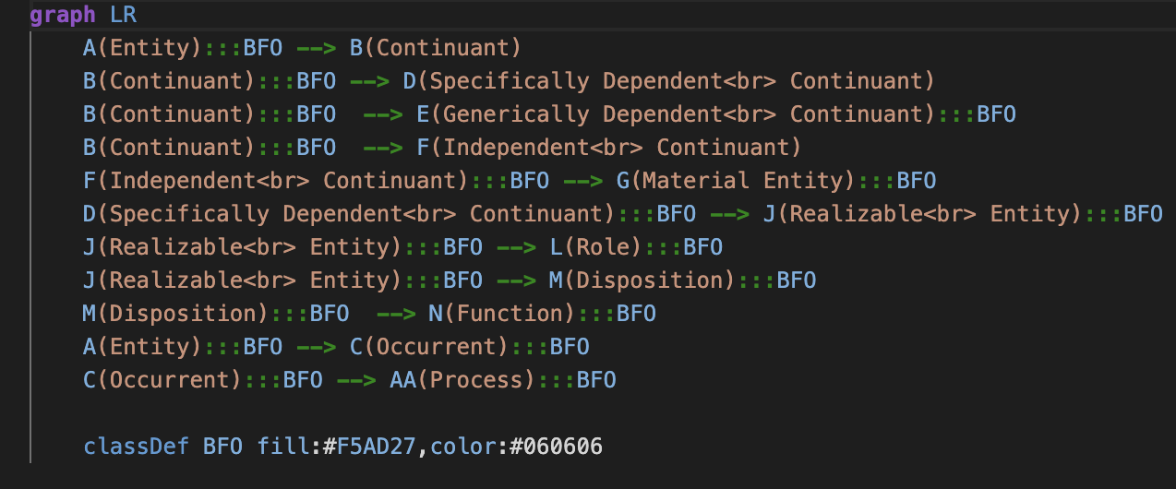
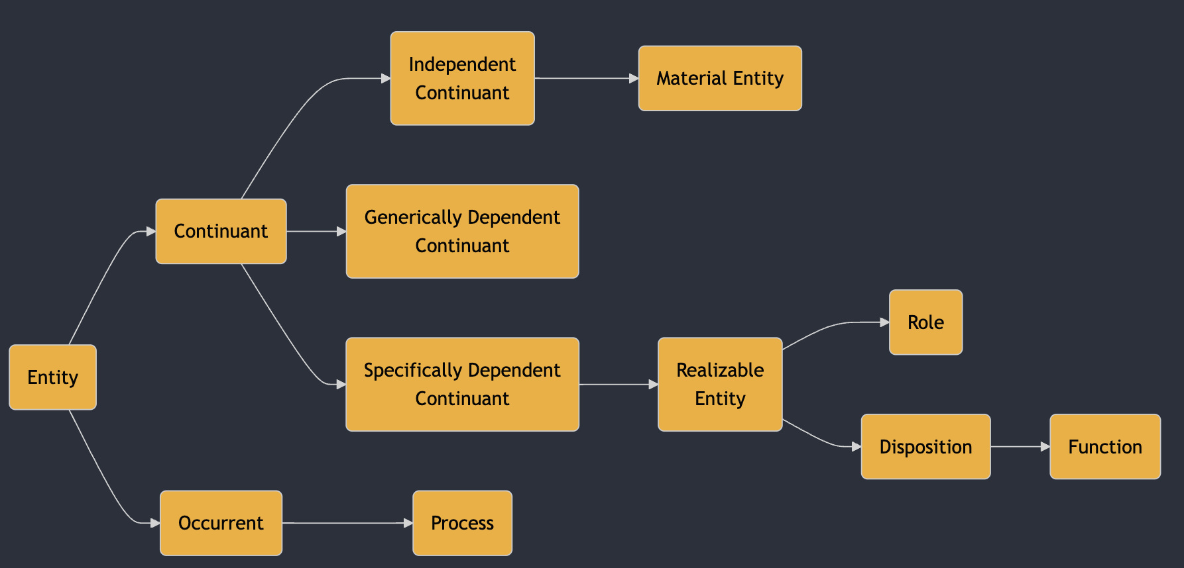

Mermaid
Mermaid is a flavor of Markdown specialized for representing diagrams
You’ll be using mermaid to represent design patterns in this course

Slide 7
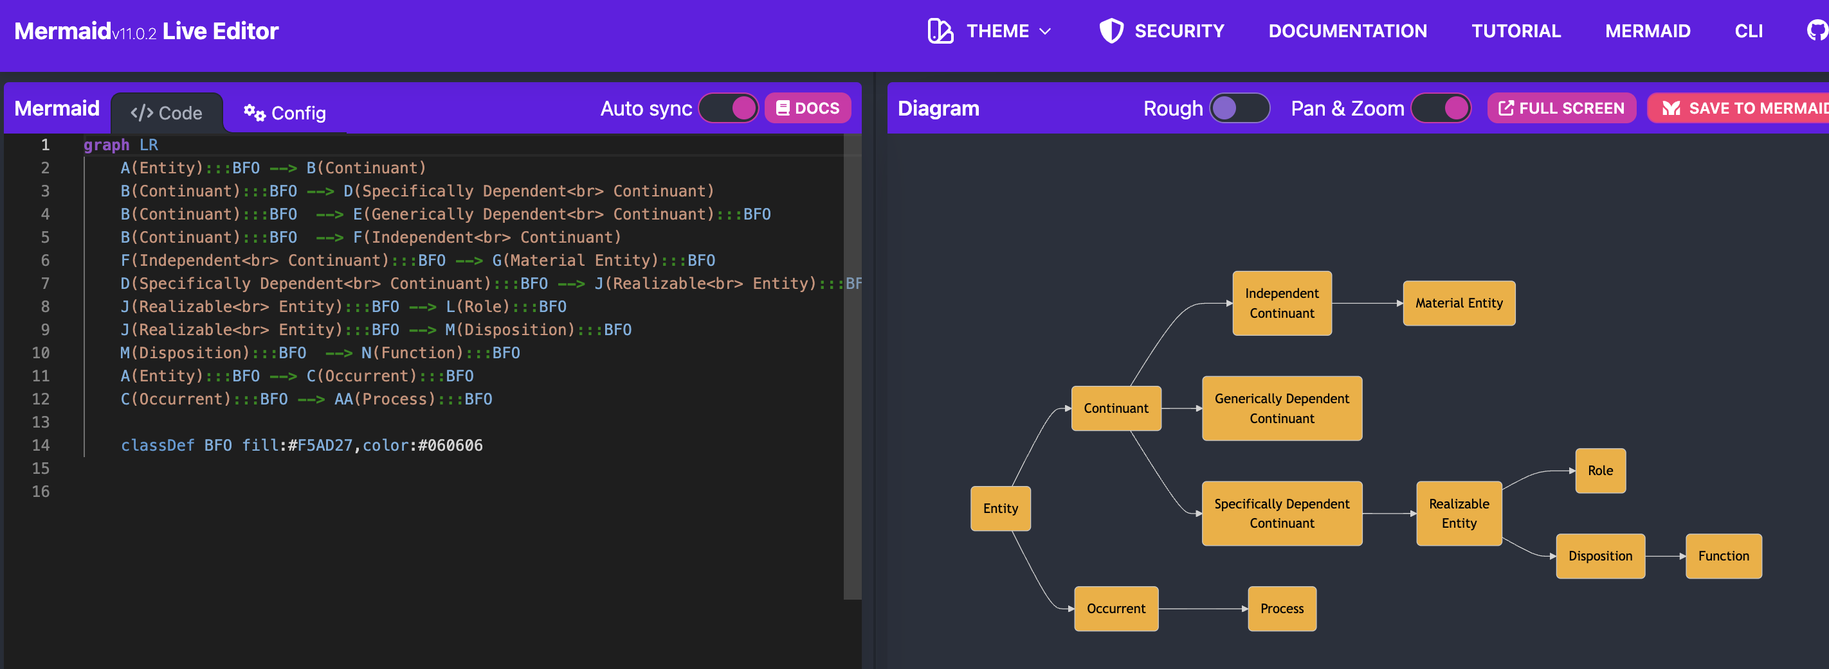
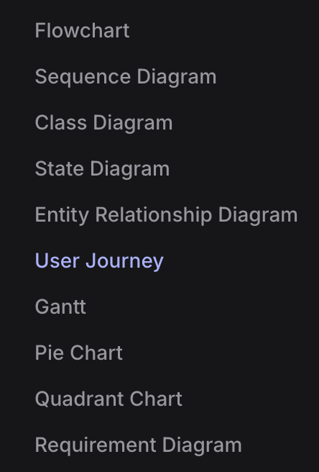
Play around in the live editor: https://mermaid.live/edit
Navigate to the helpful tutorials: https://mermaid.js.org/ecosystem/tutorials.html

